Slide 1
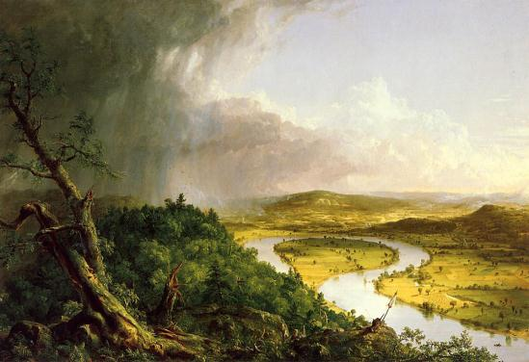

Slide 2
American Romanticism
1800-1860

Slide 3
Who were the Romantics?
In your notes…
What were the values and beliefs of the Romantics?
What is Transcendentalism?
Who were the Transcendentalists and how do their beliefs still influence American life?
The “Dark Romantics”
Who were the “Dark Romantics” and what darker side of human life did they explore in their writing?
Notes:
From 1840-1855, literature in America experienced a rebirth called the New England Renaissance. Through their poetry, short stories, novels, and other works, writers during this period established a clear American voice. No longer did they see their work as less influential than that of European authors. Transcendentalism was a part of this "flowering" of American literature. Ralph Waldo Emerson and Henry David Thoreau were important voices in this philosophical movement that sought to have individuals "transcend" to a higher spiritual level. To achieve this goal, the individual had to seek spiritual, not material, greatness and the essential truths of life through intuition. Emerson was the philosopher and teacher. Thoreau was the student and the practitioner. To learn more about this complex philosophy visit the Web of American Transcendentalism.
Discussion Questions:
How are you affected by nature? Do you find comfort in it? Do you reflect the moods of nature?
What is the role of nature in your life?
What is meant by an individual's spiritual side? How to you define it?
Is there a connection between the individual's spirit and nature? If so, what is that connection?
What does it mean to know something intuitively? For example, has a parent or a sibling ever known something was wrong with you without having talked with or seen you? What do we mean when we say "I just know it"?
How do you demonstrate that you are an individual? Do you think independently of others or do you follow the crowd?

Slide 4
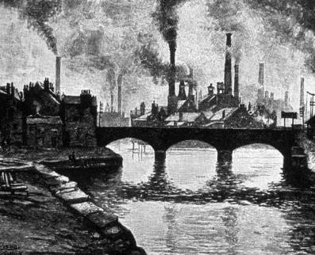
Background: The Industrial Revolution
The Industrial Revolution in Great Britain caused tremendous change in America.
Small businesses gave way to large mechanized factories.
The railroad and the steamboat allowed for wider distribution of goods.
Widespread corruption and abuse.
Northern states: manufacturing
Southern states: agriculture and slave labor
Division between northern and southern economies =

Slide 5
Background: The Industrial Revolution
The Industrial Revolution in Great Britain caused tremendous change in America.
Small businesses gave way to large mechanized factories.
The railroad and the steamboat allowed for wider distribution of goods.
Widespread corruption and abuse.
Northern states: manufacturing
Southern states: agriculture and slave labor
Division between northern and southern economies = CIVIL WAR

Slide 6
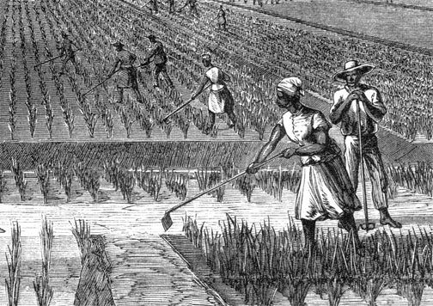
The Age of Reform
During the 1820s America ushered in an enlivened spirit and need of social and cultural reform.
Slavery,
Drunkenness
Women's rights
Prison systems
Care for the mentally ill.
Some saw a need for optimism, creativity, and intellectual freedom.
Not all writers saw this optimism

Slide 7
Who were the Romantics?
In your notes…
What were the values and beliefs of the Romantics?
What is Transcendentalism?
Who were the Transcendentalists and how do their beliefs still influence American life?
The “Dark Romantics”
Who were the “Dark Romantics” and what darker side of human life did they explore in their writing?

Slide 8
We will explore:
Optimism and Individualism
Kinship with Nature
The Dark Side of Romanticism

Slide 9
OPTIMISM AND INDIVIDUALISM

Slide 10
What is optimism?
Do you consider yourself an optimist?

Slide 11
Ralph Waldo Emerson (1803-1882)
American poet and optimist.
Born in Boston to a poor family. His father was a Unitarian minister.
Attended Harvard at age 14
Believed the individual’s uniqueness and creativity should be celebrated.
Believed that individual souls were part of a larger “Over-soul”.
Through understanding and improving the self, the individual could accomplish almost anything he or she set his or her mind to.

Slide 12
Transcendentalism
(American) Transcendentalism was a group of new ideas in literature, religion, culture, and philosophy that emerged in New England in the early to middle 19th century.
Transcendentalism began as a protest against the general state of culture and society.
Among transcendentalists' core beliefs was an ideal spiritual state that 'transcends' the physical and empirical and is only realized through the individual's intuition, rather than through the doctrines of established religions.

Slide 13
Transcendentalism – huh?
Transcendentalism was a group of new ideas that emerged as a result of the protests against popular thought and intellectualism. It stressed the belief that the individual's spiritual state "transcends" the physical world and is arrived at through intuition rather than religious doctrine.

Slide 14
Transcendentalism – even simpler please!
Transcendentalism is the belief that the basic truths of the universe lie beyond (or transcend) what we obtain from our senses.

Slide 15
Emerson’s aphorisms
An aphorism is an original thought, spoken or written in a concise and memorable form.
Ralph Waldo Emerson
(1803-1882)

Slide 16
KINSHIP WITH Nature

Slide 17
Ralph Waldo Emerson (1803-1882)
American poet and optimist.
Born in Boston to a poor family. His father was a Unitarian minister.
Attended Harvard at age 14
Believed the individual’s uniqueness and creativity should be celebrated.
Believed that individual souls were part of a larger “Over-soul”.
Through understanding and improving the self, the individual could accomplish almost anything he or she set his or her mind to.
THE TEACHER

Slide 18
Henry David Thoreau (1817-1862)
Born in Concord, Massachusetts
Intelligent, educated, well known failure.
Graduated from Harvard University
Well read in English literature and German philosophers
Failed schoolteacher
Moved to Walden Pond at age 28.
“The mass of men lead lives of quiet desperation”
THE STUDENT

Slide 19
The DARK Side of ROMANTICISM

Slide 20
Edgar Allen Poe
“The want of parental affection has been the heaviest of my trials.”
Orphaned at age three
John and Frances Allen became his foster parents
Foster father disapproved of his literary ambitions.
Enrolled at the University of Virginia at seventeen.
Incurred gambling debt and disowned by his foster parents
Jobless, he joined the army
Enrolled at West Point but eventually left
Moved in with his Aunt in Baltimore and married his thirteen year old cousin, Virginia
Wife died of tuberculosis
Died mysteriously after being found drunk and delirious in a Baltimore tavern
1809-1849

Slide 21
symbolic meaning
symbols
A symbol is a concrete object, person, a place or an action that works on at least two levels. It functions as itself and also suggests a deeper meaning.
The symbolic meaning of a story emerges from an overall interpretation of the story’s individual symbols.

