Slide 1
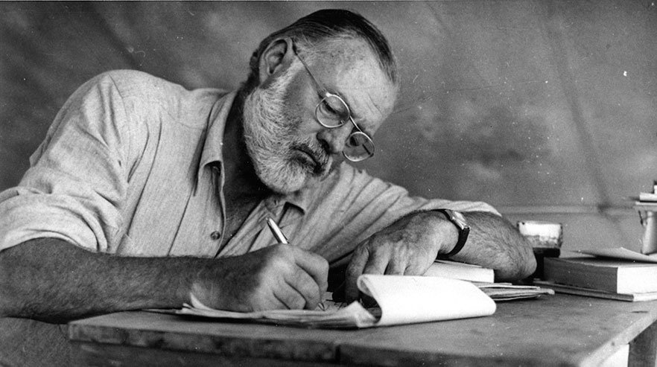
Ernest Hemingway
(1899–1961)
An introduction to the real most
interesting man in the world

Slide 2
"This is to tell you about a young writer named Ernest Hemingway, who lives in Paris... has a brilliant future. I'd look him up right away. He's the real thing."
-F. Scott Fitzgerald to his editor
Max Perkins, 1924

Slide 3
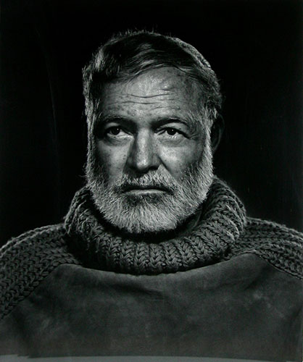
Who is Ernest Hemingway?
He was an American author and journalist.
Writer of seven novels, two nonfiction accounts of his experiences in Spain and Africa, and numerous short stories and articles
His best known work is his novel A Farewell to Arms, 1929
Won the Pulitzer Prize for The Old Man and the Sea, 1952
Won the Nobel Prize in Literature in 1954

Slide 4
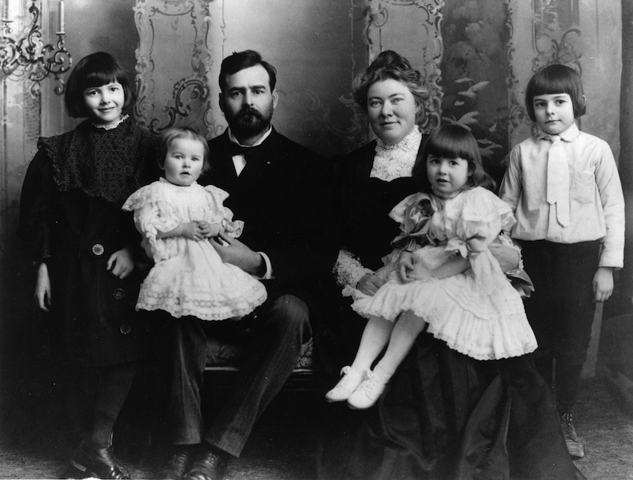
Early Life
Born in Oak Park, Illinois in 1899.
One of six children of Clarence and Grace Hemingway.
His conservative parents were not ready for the sexual openness of his novels. Later, when his first novel The Sun Also Rises was to be discussed at his mother's book club, she was not present.

Slide 5
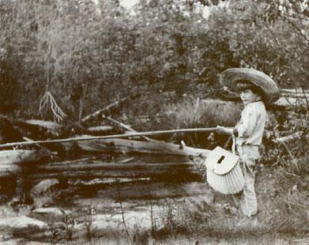
Early Life
Ernest and his family spent summers at
Walloon Lake in Michigan.
These outings gave him an
early appreciation for wild
terrain
and inspired the settings for
some of his short stories.

Slide 6
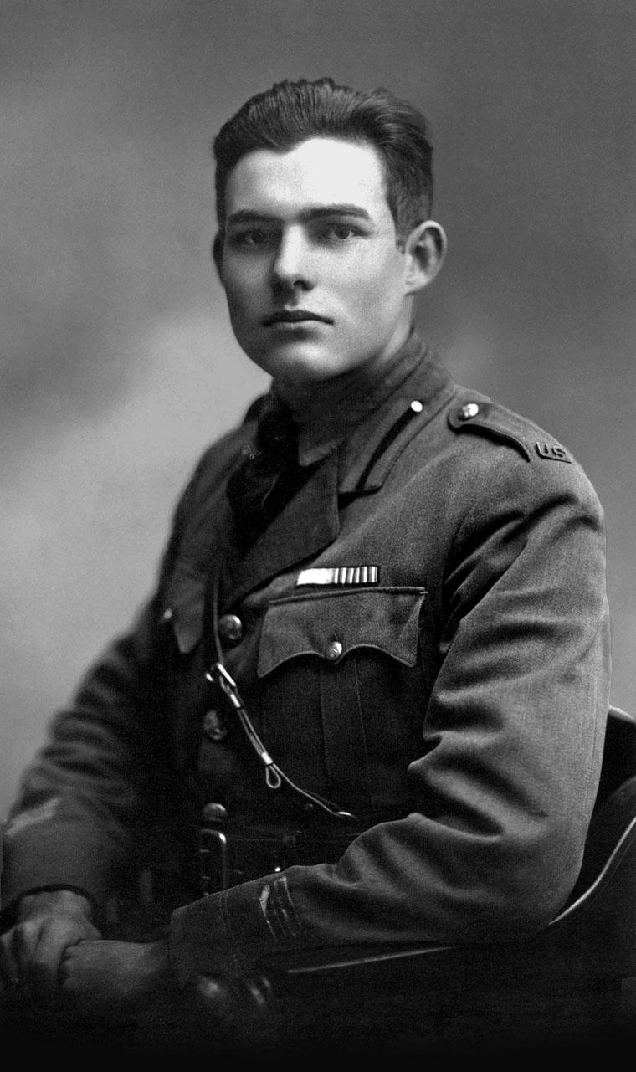
Early Life
He attended Oak Park and River Forest High School from 1913-1917 where he took part in a number of sports—
boxing, track and field, water polo, and football and had good grades in English classes.
After graduation he moved to take a job as a reporter with the Kansas City Star.
In 1918 he entered World War I as a member of the Red Cross Ambulance Corps
His experience in WWI inspired his novel
A Farewell to Arms.

Slide 7
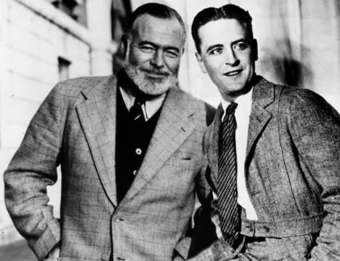
Paris
Married Hadley Richardson in 1922 and moved to Paris, where he worked as a foreign correspondent.
Wrote short stories and his novel The Sun Also Rises which got favorable reviews in 1926.
In 1926 Hemingway and Richardson separated and he met Pauline Pfeiffer, whom he married in 1927
Met F. Scott Fitzgerald in Paris 1925; Fitzgerald had just published The Great Gatsby.

Slide 8
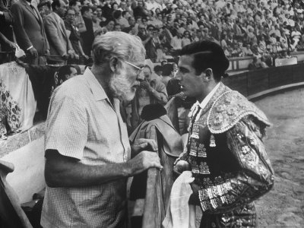
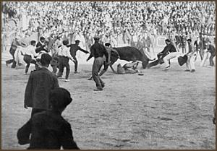
Bullfighting
In 1923, Hemingway saw his first bullfight in Pamplona, Spain.
The sport became one of his life's passions.
This inspired his novel
The Sun Also Rises.

Slide 9
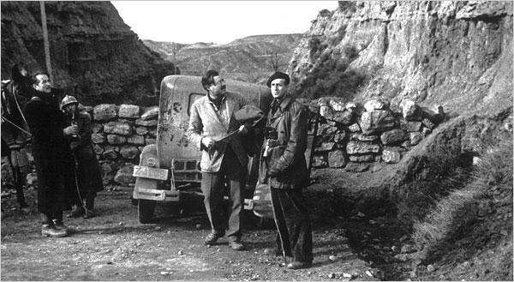
Spain
In 1937 Hemingway worked as a reporter covering the Spanish Civil War.
Met writer Martha Gellhorn whom he married in 1938 after his divorce from Pauline.

Slide 10
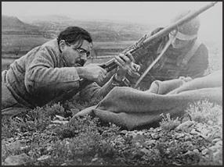
Spain
His war experiences in Spain inspired "one of the major novels in American literature," For Whom the Bell Tolls.
As a reporter, he liked being part of the action.
Here, Hemingway helps a Loyalist soldier unjam his rifle

Slide 11
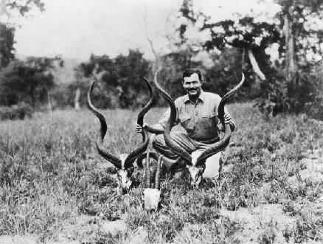
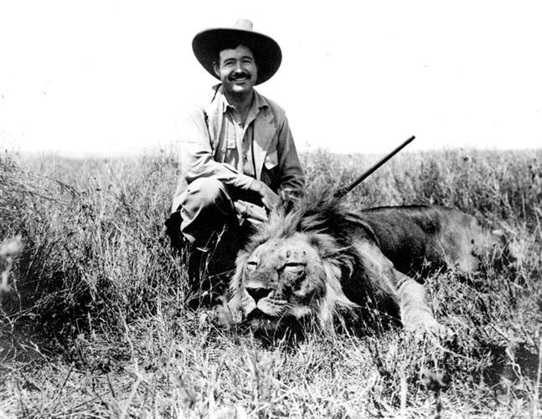
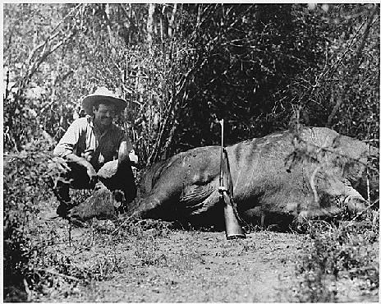
Africa
Big game hunting became another of Hemingway's life's passions

Slide 12
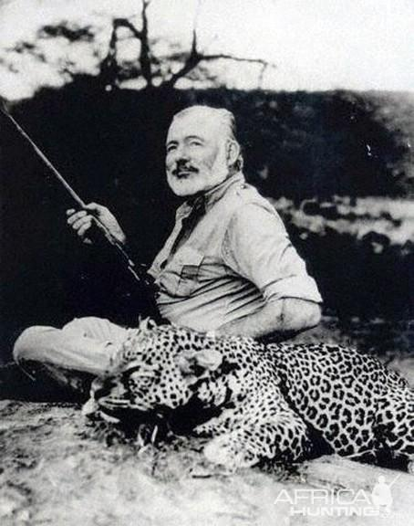
Africa
On safari in 1953, drinking heavily,
he took up with a native girl while his wife was shopping in Nairobi.
He shaved his head in the name of "going native", dyed his clothes a rusty color to match the hue favored among the local Masai people, and went hunting with a spear.

Slide 13
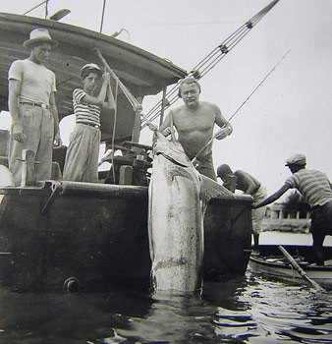
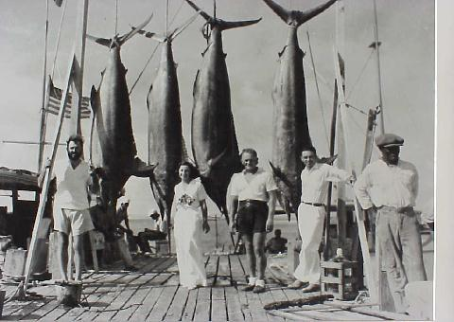
Deep-sea fishing
Hemingway enjoyed fishing off Key West. By the mid 30s he became known as one of the best-known fishermen in America.

Slide 14
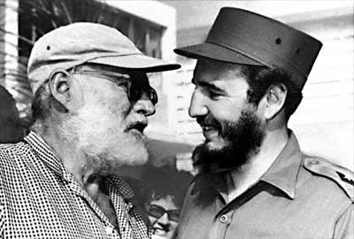
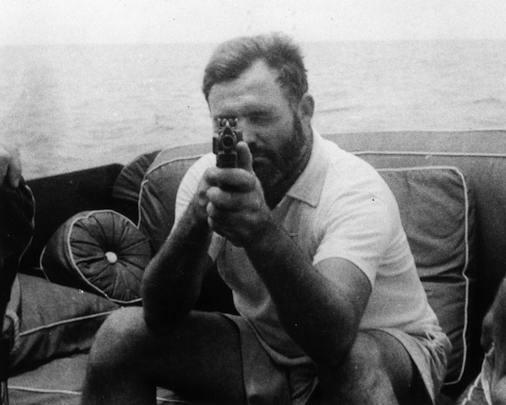
World War II
When war broke out, Hemingway moved from Key West to Cuba, where he convinced the Cuban government to help him
refit his ship The Pilar for ambushing
German submarines.

Slide 15
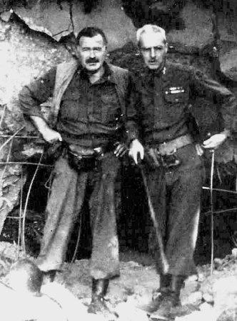
World War II
Not satisfied, he went to Europe from June- December 1944 and was present at the D-Day invasion.
Supposed to be merely an observer, "Hemingway got into considerable trouble playing infantry captain to a group of Resistance people that he gathered because a correspondent is not supposed to lead troops, even if he does it well."
-Historian Paul Fussell
Met fourth wife Mary Welsh in 1946.
In 1947 awarded a Bronze Star for bravery in combat.

Slide 16
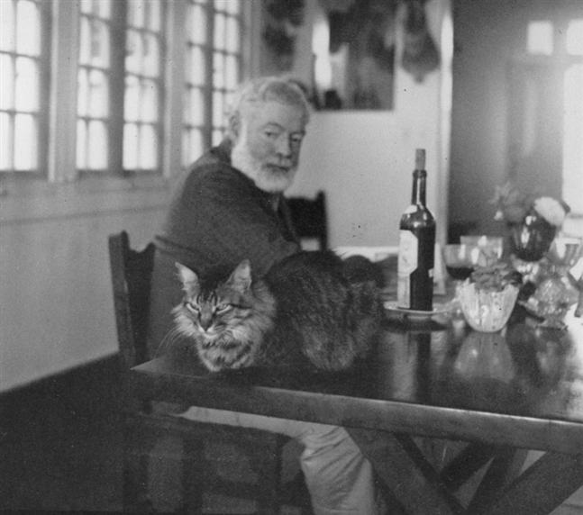
Later Years
A heavy drinker all his life, Hemingway's health began to fail.
Growing increasingly depressed, paranoid and unstable in his later years, he was admitted to the Mayo Clinic in Minnesota in 1960 where he received up to 15 rounds of electroshock therapy.
July 2, 1961, following several
rounds of electroshock therapy,
he "quite deliberately"
shot himself with his
favorite shotgun.

Slide 17
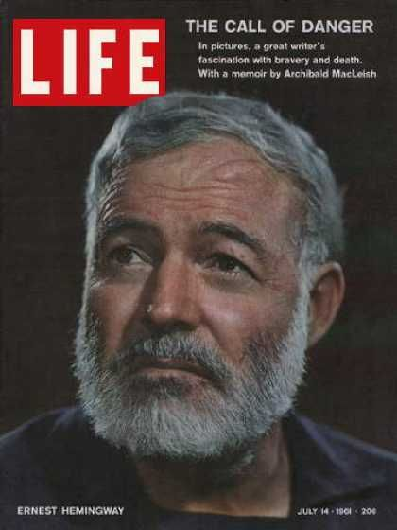
Later years
Life magazine published the novella
The Old Man and the Sea in a single issue in 1952, and within 48 hours, all
5.3 million copies were sold.
Hemingway received the Nobel Prize for Literature in 1954

Slide 18
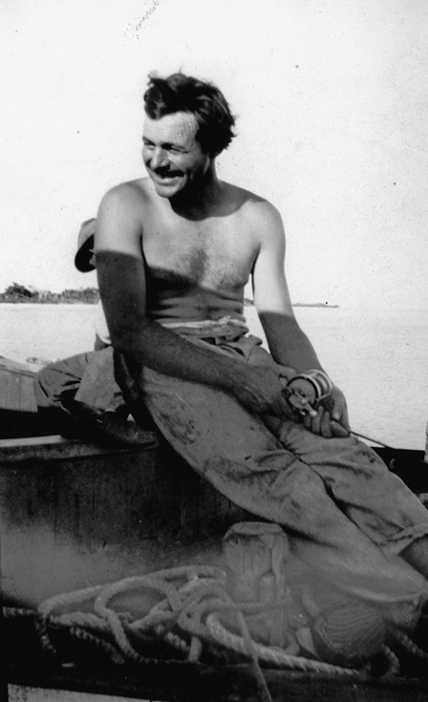
"For a true writer each book should be a new beginning where he tries again for something that is beyond attainment. He should always try for something that has never been done or that others have tried and failed. Then sometimes, with great luck, he will succeed."
-Hemingway upon receiving the Nobel Prize, 1954

Slide 20
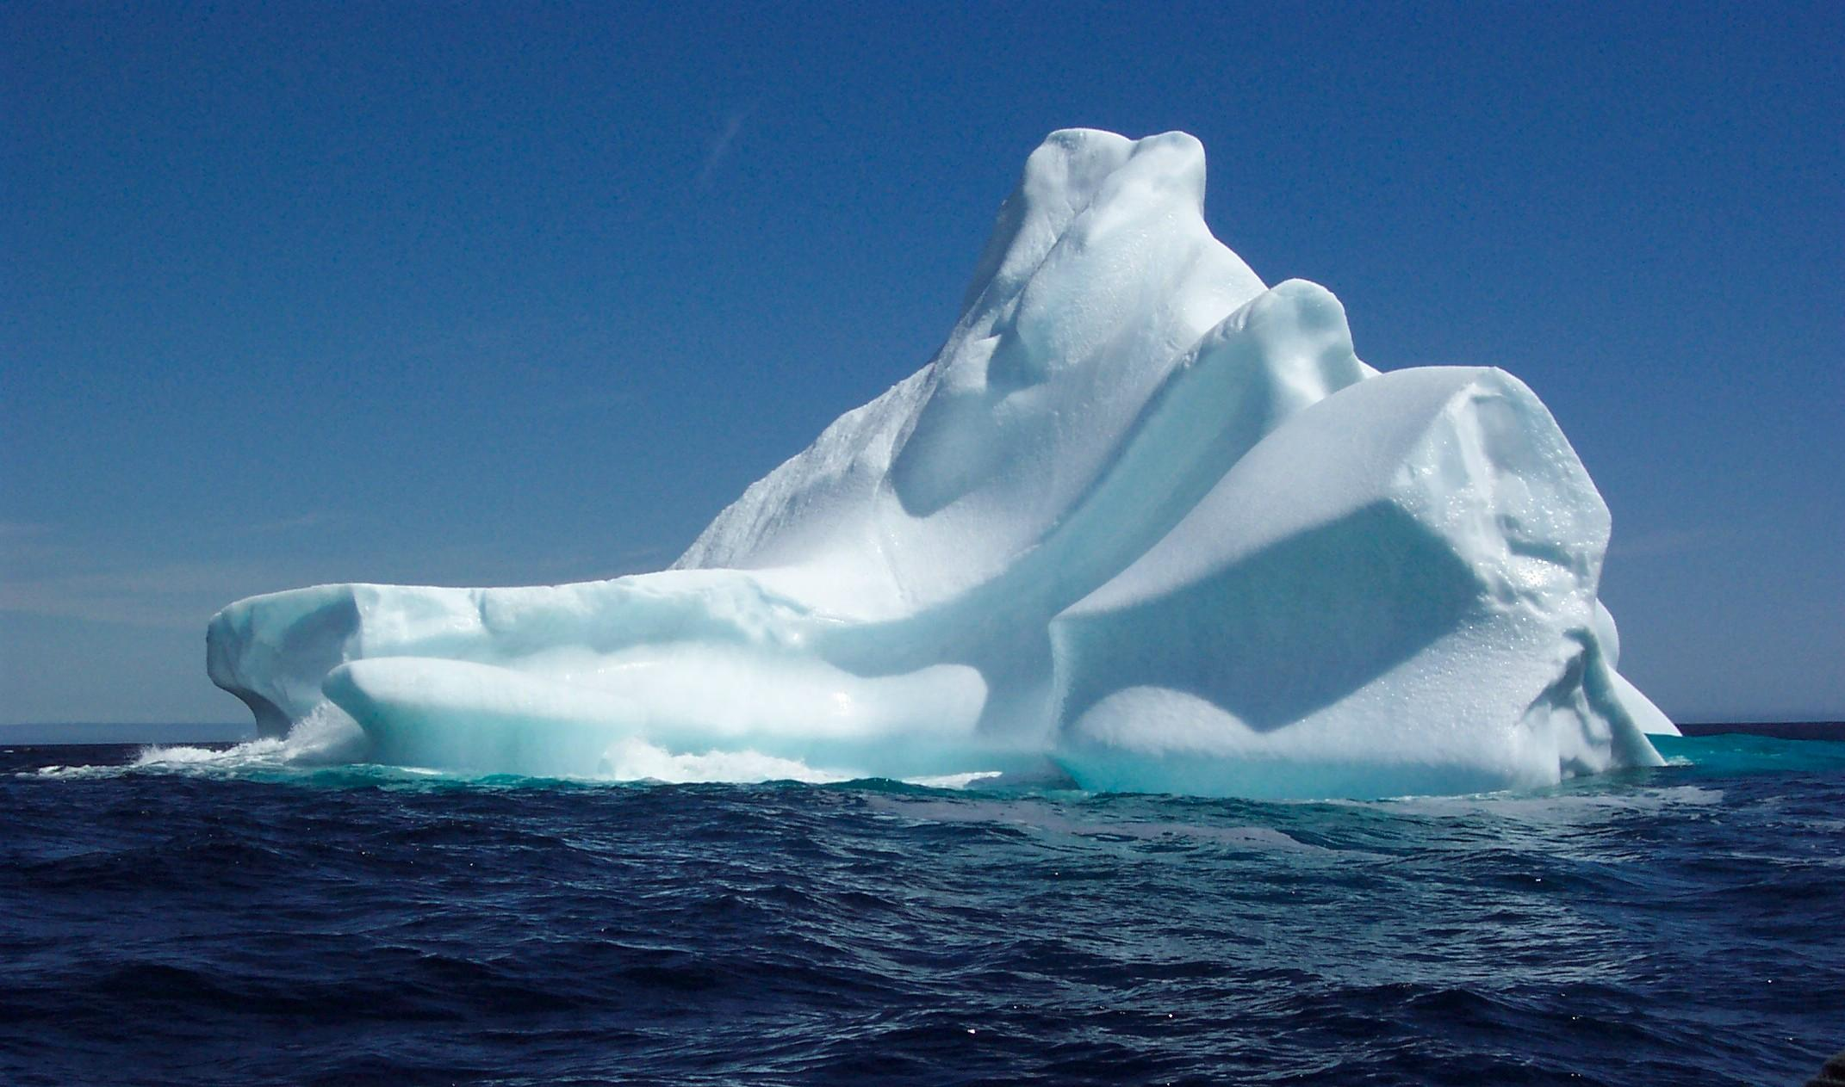

Slide 21
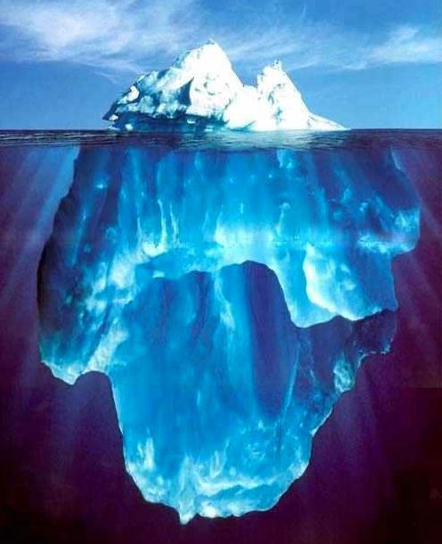

Slide 22
"I always try to write on the principle of the iceberg. There is seven-eights of it under water for every part that shows. Anything you know you can eliminate and it only strengthens your iceberg. It is the part that doesn't show."
-Ernest Hemingway, 1958

