Slide 1
The Writing Process
A wealth of helpful information
Writing tips gathered from
Purdue University’s
Online Writing Lab
http://owl.english.purdue.edu

Slide 2
Writing a Great Thesis Sentence

Slide 3
What is a thesis?
thesis
[thee-sis] noun, plural the· ses [thee-seez]
a proposition stated or put forward for consideration, especially one to be discussed and proved or to be maintained against objections: He vigorously defended his thesis on the causes of war.
a subject for a composition or essay.
a dissertation on a particular subject in which one has done original
research.

Slide 4
What is a thesis?
A thesis sentence presents the main idea for a scholarly paper or essay.
It controls the development and structure of a paper.
It summarizes the main points or sections of your paper.

Slide 5
Some things to consider:
Which three texts have you chosen to write about?
What connections have you made between them?
What topics will make up the sections of your paper?

Slide 6
Components of a thesis
Topic: The works of Thoreau, Emerson and Whitman
Position: Americans are blessed with an abiding optimism and enduring work ethic, even in the face of hard work and setbacks.
Reason: I have made this conclusion after reading Thoreau’s “Walden”, Emerson’s “Self-Reliance” and Whitman’s “I Hear American Singing”.

Slide 7
Components of a thesis
Topic: The works of Thoreau, Emerson and Whitman
Position: Americans are blessed with an abiding optimism and enduring work ethic, even in the face of hard work and setbacks.
Reason: I have made this conclusion after reading Thoreau’s “Walden”, Emerson’s “Self-Reliance” and Whitman’s “I Hear American Singing”.

Slide 8
Components of a thesis
Topic: The works of Thoreau, Emerson and Whitman
Position: Americans are blessed with an abiding optimism and enduring work ethic, even in the face of hard work and setbacks.
Reason: I have made this conclusion after reading Thoreau’s “Walden”, Emerson’s “Self-Reliance” and Whitman’s “I Hear American Singing”.

Slide 9
Components of a thesis
Topic: The works of Thoreau, Emerson and Whitman
Position: Americans are blessed with an abiding optimism and enduring work ethic, even in the face of hard work and setbacks.
Reason: I have made this conclusion after reading Thoreau’s “Walden”, Emerson’s “Self-Reliance” and Whitman’s “I Hear American Singing”.

Slide 10
A Sample Thesis
Now put it all together. Make sure that your thesis is a single declarative sentence (not a question):
By examining themes and images in Thoreau’s “Walden”, Emerson’s “Self-Reliance” and Whitman’s “I Hear American Singing” I have concluded that, in the authors’ views, Americans are blessed with an abiding optimism and enduring work ethic, even in the face of hard work and setbacks.

Slide 11
Peer Review
Is the thesis a single, complete declarative sentence (not a question)?
Does the thesis state the writer’s topic?
Does it state the writer’s position?
Does the thesis state the reason for this position?
Does the thesis establish a basis for the sections of your paper?

Slide 12
Writing a Great Thesis Sentence

Slide 13
Thesis Sentence
A thesis sentence presents the main idea for a scholarly paper or essay.
It controls the development and structure of a paper.
It is usually the last sentence of an introductory paragraph.

Slide 14
Some things to consider:
What do you want to know about your chosen career? What aspects of this profession will you need to research?
Make a list now!

Slide 15
Some things to consider:
What do you want to know about your chosen career? What aspects of this profession will you need to research?
Make a list now!
These topics will become the paragraphs in your paper.

Slide 16
The answer to your questions
What career have you decided you are suitable for?

Slide 17
The answer to your questions
What career have you decided you are suitable for?
What will you have to research in order to support that conclusion?

Slide 18
Components of a thesis
Topic:
Position:
Reason:

Slide 19
Components of a thesis
Topic: Auto mechanic
Position:
Reason:

Slide 20
Components of a thesis
Topic: Auto mechanic
Position: I have determined that this career is ideal for me
Reason:

Slide 21
Components of a thesis
Topic: Auto mechanic
Position: I have determined that this career is ideal for me
Reason: I have done research into the education and skills required, wages, benefits, schedule and job opportunities in this field

Slide 22
Sample Theses
By examining issues such as level of education needed; skills required; salary; _________________; ________________; ______________; and the connection between my career and high school, I find myself to be highly suited to a career in education.

Slide 23
Sample Theses
By examining issues such as level of education needed; skills required; salary; benefits; job outlook and availability; personal fulfillment; and the connection between my career and high school, I find myself to be highly suited to a career in education.

Slide 24
Sample Theses
My suitability for a career in firefighting is obvious after researching the levels of education needed; skills required; salary; benefits; _______________________; ______________________; and ___________________.

Slide 25
Sample Theses
My suitability for a career in firefighting is obvious after researching the levels of education needed; skills required; salary; benefits; job outlook and availability; personal fulfillment; and the connection between my career and high school.

Slide 26
Sample Theses
The administrative environment proves to be highly suited to my career needs and values because of the level of education required; skills required; salary; benefits; ___________________; __________________; and _________________.

Slide 27
Sample Theses
The administrative environment proves to be highly suited to my career needs and values because of the level of education required; skills required; salary; benefits; job outlook and availability; the ability to be innovative in my field; and the connection between my career and high school.

Slide 28
Peer Review
Is the thesis a single, complete declarative sentence (not a question)?
Does the thesis state the writer’s topic?
Does it state the writer’s position?
Does the thesis state the reason for this position?
Does the thesis establish a basis for the sections of your paper?

Slide 29
Creating an Outline
A wealth of helpful information
Writing tips gathered from
Purdue University’s
Online Writing Lab
http://owl.english.purdue.edu

Slide 30
Why create an outline?
For research papers, an outline may help you keep track of large amounts of information.
Creating an outline before writing your paper will make organizing your thoughts a lot easier.
An outline:
Constructs an ordered overview of your writing

Slide 31
Why create an outline?
For research papers, an outline may help you keep track of large amounts of information.
Creating an outline before writing your paper will make organizing your thoughts a lot easier.
An outline:
Aids in the process of writing
Helps you organize your ideas
Presents your material in a logical form
Shows the relationships among ideas in your writing
Constructs an ordered overview of your writing

Slide 32
How do I create an outline?
Develop a thesis for your paper
Do research - gather quotes and data from your sources
Decide on the content of your paper sections

Slide 33
Then:
Brainstorm:
Organize:
Order:
Label:

Slide 34
Then:
Brainstorm: List all the ideas that you want to include in your paper.
Organize:
Order:
Label:

Slide 35
Then:
Brainstorm: List all the ideas that you want to include in your paper.
Organize: Group related ideas together.
Order:
Label:

Slide 36
Then:
Brainstorm: List all the ideas that you want to include in your paper.
Organize: Group related ideas together.
Order: Arrange material in paragraphs from general to specific or from abstract to concrete.
Label:

Slide 37
Then:
Brainstorm: List all the ideas that you want to include in your paper.
Organize: Group related ideas together.
Order: Arrange material in paragraphs from general to specific or from abstract to concrete.
Label: Create headings for sections

Slide 38
Career Topics
Education required
Responsibilities/ Skills required
Working conditions
Salary
Benefits
Job outlook/ Availability

Slide 39
I. Introduction
Attention grabber
Personal info – why you chose this career
Background – a little history on this career
Thesis sentence
II. Level of Education – Topic sentence
Lead-in to quotation
Direct quotation:
Explanation of quotation
Lead-in to quotation
Direct quotation:
Explanation of quotation
Closing sentence – transition to next topic
III. Responsibilities/Skills Required – Topic sentence
Lead-in to quotation
Direct quotation:
Explanation of quotation
Lead-in to quotation
Direct quotation:
Explanation of quotation
Closing sentence – transition to next topic
IV. Working Conditions – Topic sentence
Lead-in to quotation
Direct quotation
Explanation of quotation
Lead-in to quotation
Direct quotation
Explanation of quotation
Closing sentence – transition to next topic
V. Benefits – Topic sentence
Lead-in to quotation
Direct quotation:
Explanation of quotation
Lead-in to quotation
Direct quotation:
Explanation of quotation
Closing sentence – transition to next topic
VI. Job Outlook/Availability – Topic sentence
Lead-in to quotation
Direct quotation:
Explanation of quotation
Lead-in to quotation
Direct quotation:
Explanation of quotation
Closing sentence – transition to next topic
VII. Conclusion
Restate thesis
Show significance of the paper – Is this something you can see yourself doing every day?
Powerful concluding thoughts – what did you learn about yourself in this process?

Slide 40
Introductory paragraph
I. Introduction
Attention grabber
Personal info – why you chose this career
Background – a little history on this career
Thesis sentence

Slide 41
Body paragraphs
II. Level of Education Required
Topic Sentence
Direct quotation (Source name)
Direct quotation (Source name)
Closing sentence – transition to next topic

Slide 42
Body paragraphs
II. Level of Education Required
Topic Sentence
Lead-in to quotation
Direct quotation (Source name)
Explanation of Quotation
Lead-in to quotation
Direct quotation (Source name)
Explanation of Quotation
Closing sentence – transition to next topic

Slide 43
Concluding paragraph
VII. Conclusion
Restate thesis
Show significance of the paper – Is this something you can see yourself doing every day?
Powerful concluding thoughts – what did you learn about yourself in this process?

Slide 44
I. Introduction
Attention grabber
Personal info – why you chose this career
Background – a little history on this career
Thesis sentence
II. Level of Education – Topic sentence
Lead-in to quotation
Direct quotation:
Explanation of quotation
Lead-in to quotation
Direct quotation:
Explanation of quotation
Closing sentence – transition to next topic
III. Responsibilities/Skills Required – Topic sentence
Lead-in to quotation
Direct quotation:
Explanation of quotation
Lead-in to quotation
Direct quotation:
Explanation of quotation
Closing sentence – transition to next topic
IV. Working Conditions – Topic sentence
Lead-in to quotation
Direct quotation
Explanation of quotation
Lead-in to quotation
Direct quotation
Explanation of quotation
Closing sentence – transition to next topic
V. Benefits – Topic sentence
Lead-in to quotation
Direct quotation:
Explanation of quotation
Lead-in to quotation
Direct quotation:
Explanation of quotation
Closing sentence – transition to next topic
VI. Job Outlook/Availability – Topic sentence
Lead-in to quotation
Direct quotation:
Explanation of quotation
Lead-in to quotation
Direct quotation:
Explanation of quotation
Closing sentence – transition to next topic
VII. Conclusion
Restate thesis
Show significance of the paper – Is this something you can see yourself doing every day?
Powerful concluding thoughts – what did you learn about yourself in this process?

Slide 45
Writing Topic Sentences
A wealth of helpful information
Writing tips gathered from
Purdue University’s
Online Writing Lab
http://owl.english.purdue.edu

Slide 46
Topic Sentences
Topic sentences are the first sentence of a paragraph, representing the entirety of that paragraph

Slide 47
Topic Sentences
Practice:
Making French Toast involves three easy steps. First, get a couple of eggs from the refrigerator, and after cracking them open, stir them together with a fork until evenly blended. Second, add a little milk and vanilla, and then begin dipping your toast in the mixture until the egg soaks into the bread. Third, cook the pieces on a low temperature in the skillet for five minutes, standing close by to ensure that it doesn't burn. When finished, serve with syrup, whipped cream, and your favorite jam.

Slide 48
Topic Sentences
Practice:
Making French Toast involves three easy steps. First, get a couple of eggs from the refrigerator, and after cracking them open, stir them together with a fork until evenly blended. Second, add a little milk and vanilla, and then begin dipping your toast in the mixture until the egg soaks into the bread. Third, cook the pieces on a low temperature in the skillet for five minutes, standing close by to ensure that it doesn't burn. When finished, serve with syrup, whipped cream, and your favorite jam.

Slide 49
Topic Sentences
Here’s an example:
A post-secondary education can have very positive effects on income and employment. Numerous studies conducted in the United States over the past ten years have demonstrated that earnings for anyone with a post-secondary education are on average twenty percent higher than the earnings of those whose education stopped with a high school diploma. Incomes are higher still for those with four-year degrees, and even higher at the master’s and doctoral levels. Regardless of the post-secondary degree level, graduates are fifteen percent less likely to be laid off in difficult economic times.

Slide 50
Topic Sentences
Here’s an example:
A post-secondary education can have very positive effects on income and employment. Numerous studies conducted in the United States over the past ten years have demonstrated that earnings for anyone with a post-secondary education are on average twenty percent higher than the earnings of those whose education stopped with a high school diploma. Incomes are higher still for those with four-year degrees, and even higher at the master’s and doctoral levels. Regardless of the post-secondary degree level, graduates are fifteen percent less likely to be laid off in difficult economic times.

Slide 51
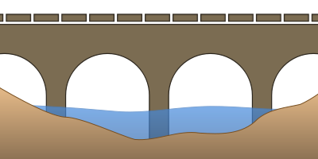
Topic Sentences
When they are used to their fullest potential, topic sentences also become a bridge between the previous paragraph and the next one.

Slide 52
Topic Sentences
Consider this next example:
In addition to the economic benefits, a post-secondary education can provide very clear cultural benefits. People with post-secondary degrees...

Slide 53
Topic Sentences
Practice:
The writing process consists of four main stages: gather, organize, write, revise. The gathering stage consists of researching, brainstorming, and analyzing in order to come up with a thesis. The next stage, organization, requires you to think about a logical and persuasive arrangement for your various ideas. The writing stage requires you to sit down and, following and outline, construct your essay. The fourth and final stage involves endless revision: going over and over what you've written to make it better.

Slide 54
Topic Sentences
Practice:
The writing process consists of four main stages: gather, organize, write, revise. The gathering stage consists of researching, brainstorming, and analyzing in order to come up with a thesis. The next stage, organization, requires you to think about a logical and persuasive arrangement for your various ideas. The writing stage requires you to sit down and, following and outline, construct your essay. The fourth and final stage involves endless revision: going over and over what you've written to make it better.

Slide 55
Writing Paragraphs
A wealth of helpful information
Writing tips gathered from
Purdue University’s
Online Writing Lab
http://owl.english.purdue.edu

Slide 56
What is a paragraph?
A paragraph is a collection of related sentences dealing with a single topic.
Learning to write good paragraphs will help you as a writer stay on track during your drafting and revision stages.
Good paragraphing helps your readers to follow your writing.
You can have fantastic ideas, but if those ideas aren't presented in an organized fashion, you will lose your readers.

Slide 57
Rules for Paragraphs
The basic rule of thumb with paragraphing is to keep one idea to one paragraph. If you begin to transition into a new idea, it belongs in a new paragraph.
Each paragraph should deal with one idea and several bits of supporting evidence. You can also have several points in a single paragraph as long as they relate to the overall topic of the paragraph.
If the single points start to get long, then elaborate on each one and place them in their own paragraphs.

Slide 58
Good paragraphs should have:
Topic sentence
A topic sentence is a sentence that indicates what idea the paragraph is about. Topic sentences grow out of the ideas in your thesis.
An easy way to make sure your reader understands the topic of the paragraph is to put your topic sentence near the beginning of the paragraph.
By reading your topic sentence, your reader should be able to easily summarize what the paragraph is about.

Slide 59
Good paragraphs should have:
Unity
The entire paragraph should concern itself with a single focus. If it begins with one focus or major point of discussion, it should not end with another or wander within different ideas.

Slide 60
Good paragraphs should have:
Coherence
Coherence is the trait that makes the paragraph easily understandable to a reader.
Create Logical bridges
The same idea of a topic is carried over from sentence to sentence
Successive sentences can be constructed in parallel form

Slide 61
Good paragraphs should have:
Development
How can I make sure my paragraph is well-developed?
Use examples and illustrations
Cite data (facts, statistics, evidence, details, and others)
Examine testimony (what other people say such as quotes and paraphrases)
Use an anecdote or story
Define terms in the paragraph
Compare and contrast
Evaluate causes and reasons
Examine effects and consequences
Analyze or describe the topic
Offer a chronology of an event (time segments)

Slide 62
How do I know when to start a new paragraph?
When you begin a new idea or point.
To contrast information or ideas.
When your readers need a pause.
When you are ending your introduction or starting your conclusion.

Slide 63
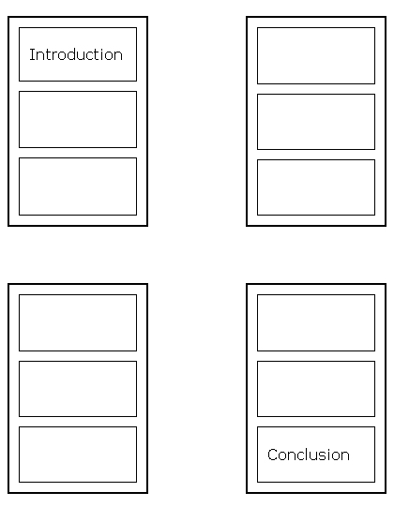

Slide 64
Body Paragraphs
The 4 Elements of a Good Paragraph:
A Transition sentence leading in from a previous paragraph to assure smooth reading.
A Topic sentence that tells the reader what you will be discussing in the paragraph.
Specific Evidence and analysis that supports one of the pieces of your thesis and that provides a deeper level of detail than your topic sentence.
A Brief wrap-up sentence that tells the reader how and why this information supports the paper’s thesis. The brief wrap-up is also known as the warrant. The warrant is important to your argument because it connects your reasoning and support to your thesis, and it shows that the information in the paragraph is related to your thesis and helps defend it.

Slide 65
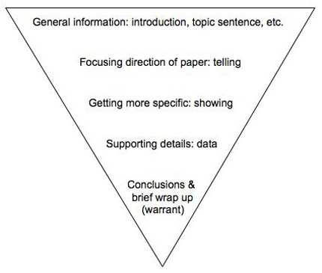
Body Paragraphs
Tell me…
Show me…
So what?
Moving from General to Specific Information

Slide 66
Quoting, Paraphrasing and Summarizing
A wealth of helpful information
Writing tips gathered from
Purdue University’s
Online Writing Lab
http://owl.english.purdue.edu

Slide 67
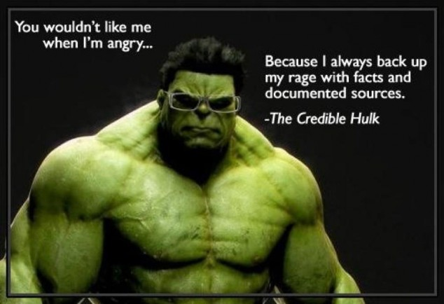

Slide 68
Using another author’s work
There are three ways to incorporate another author’s work into your own
Quotations must be identical to the original, using a narrow segment of the source. They must match the source document word for word and must be attributed to the original author.
Paraphrasing involves putting a passage from source material into your own words. A paraphrase must also be attributed to the original source. Paraphrased material is usually shorter than the original passage, taking a somewhat broader segment of the source and condensing it slightly.
Summarizing involves putting the main idea(s) into your own words, including only the main point(s). Once again, it is necessary to attribute summarized ideas to the original source. Summaries are significantly shorter than the original and take a broad overview of the source material.

Slide 69
Using another author’s work
There are three ways to incorporate another author’s work into your own
Quotations must be identical to the original, using a narrow segment of the source. They must match the source document word for word and must be attributed to the original author.
Paraphrasing involves putting a passage from source material into your own words. A paraphrase must also be attributed to the original source. Paraphrased material is usually shorter than the original passage, taking a somewhat broader segment of the source and condensing it slightly.
Summarizing involves putting the main idea(s) into your own words, including only the main point(s). Once again, it is necessary to attribute summarized ideas to the original source. Summaries are significantly shorter than the original and take a broad overview of the source material.

Slide 70
Using another author’s work
There are three ways to incorporate another author’s work into your own
Quotations must be identical to the original, using a narrow segment of the source. They must match the source document word for word and must be attributed to the original author.
Paraphrasing involves putting a passage from source material into your own words. A paraphrase must also be attributed to the original source. Paraphrased material is usually shorter than the original passage, taking a somewhat broader segment of the source and condensing it slightly.
Summarizing involves putting the main idea(s) into your own words, including only the main point(s). Once again, it is necessary to attribute summarized ideas to the original source. Summaries are significantly shorter than the original and take a broad overview of the source material.

Slide 71
Using another author’s work
There are three ways to incorporate another author’s work into your own
Quotations must be identical to the original, using a narrow segment of the source. They must match the source document word for word and must be attributed to the original author.
Paraphrasing involves putting a passage from source material into your own words. A paraphrase must also be attributed to the original source. Paraphrased material is usually shorter than the original passage, taking a somewhat broader segment of the source and condensing it slightly.
Summarizing involves putting the main idea(s) into your own words, including only the main point(s). Once again, it is necessary to attribute summarized ideas to the original source. Summaries are significantly shorter than the original and take a broad overview of the source material.

Slide 72
Using another author’s work
Quotations, paraphrases and summaries are used to add credibility to your writing!

Slide 73
Using another author’s work
Writers frequently intertwine quotations, paraphrases and summaries:
In his famous and influential work the Interpretation of Dreams, Sigmund Freud argues that dreams are the "royal road to the unconscious" (3), expressing in coded imagery the dreamer's unfulfilled wishes through a process known as the "dream-work" (4). According to Freud, actual but unacceptable desires are censored internally and subjected to coding through layers of condensation and displacement before emerging in a kind of rebus puzzle in the dream itself (6).

Slide 74
Using another author’s work
Paraphrasing is:
Your own rendition of someone else’s ideas, presented in a new form.
One legitimate way (when accompanied by accurate documentation) to borrow from a source without plagiarizing.

Slide 75
Using another author’s work
Paraphrasing is useful because:
It is better than quoting information from an undistinguished passage.
It helps you control the temptation to quote too much.
The mental process required for successful paraphrasing helps you to grasp the full meaning of the original passage.

Slide 76
Practice
The original passage:
Students frequently overuse direct quotation in taking notes, and as a result they overuse quotations in the final [research] paper. Probably only about 10% of your final manuscript should appear as directly quoted matter. Therefore, you should strive to limit the amount of exact transcribing of source materials while taking notes.
Lester, James D. Writing Research Papers. 2nd ed. (1976): 46-47.

Slide 77
Practice
An acceptable summary:
Students should take just a few notes in direct quotation from sources to help minimize the amount of quoted material in a research paper (Lester 46-47).

Slide 78
Practice
The legitimate paraphrase:
In research papers students often quote excessively, failing to keep quoted material down to a desirable level. Since the problem usually originates during note taking, it is essential to minimize the material recorded verbatim (Lester 46-47).

Slide 79
Practice
A plagiarized version:
Students often use too many direct quotations when they take notes, resulting in too many of them in the final research paper. In fact, probably only about 10% of the final copy should consist of directly quoted material. So it is important to limit the amount of source material copied while taking notes.

Slide 80
Practice
Now you’ll try:
Read Roger Sipher’s article on mandatory school attendance laws and practice quoting, summarizing and paraphrasing

Slide 81
Practice
Example quotation:
According to Roger Sipher, a solution to the perceived crisis of American education is to "Abolish compulsory-attendance laws and allow only those who are committed to getting an education to attend" (para. 3).

Slide 82
Practice
Example summary:
Roger Sipher makes his case for getting rid of compulsory-attendance laws in primary and secondary schools with six arguments. These fall into three groups—first that education is for those who want to learn and by including those that don't want to learn, everyone suffers. Second, that grades would be reflective of effort and elementary school teachers wouldn't feel compelled to pass failing students. Third, that schools would both save money and save face with the elimination of compulsory-attendance laws.

Slide 83
Practice
Example paraphrase of the essay’s conclusion:
Roger Sipher concludes his essay by insisting that schools have failed to fulfill their primary duty of education because they try to fill multiple social functions (para. 17).

Slide 84
Writing Your Introduction
A wealth of helpful information
Writing tips gathered from
Purdue University’s
Online Writing Lab
http://owl.english.purdue.edu

Slide 85
Introductions
You know your thesis goes into your intro, but what else goes into your introductory paragraph?
Introduce your topic
Create interest
Provide necessary background information
Identify your main idea
Preview the rest of your essay

Slide 86
Introductions
Set the context – provide general information about your topic explaining giving a reader a context for the information you are about to provide.
State why the main idea is important – tell the reader why s/he should care and keep reading. Why is your topic important?
State your thesis/claim – this final sentence provides the point that you’re going to prove in the body of your paper

Slide 87
Introductions
What is one important goal you would like to achieve in the next few years? In your essay, identify that one goal and explain how you plan to achieve it. Use your personal observations, experience, and knowledge to support your essay.
Making goals for myself and working toward them keeps me on my toes and makes my life interesting. There are many goals that I would like to achieve throughout my life. I have begun working toward many of them by looking into going back to school and thinking about what I’d like to do for a career. One major goal I would like to accomplish in the next few years is getting a better job. My plan to get a better job is to finish school, prepare a resume, and then search for jobs.

Slide 88
Introductions
Which sentences do the following?
Introduce your topic
Create interest
Provide necessary background information
Identify your main idea
Preview the rest of your essay
Making goals for myself and working toward them keeps me on my toes and makes my life interesting. There are many goals that I would like to achieve throughout my life. I have begun working toward many of them by looking into going back to school and thinking about what I’d like to do for a career. One major goal I would like to accomplish in the next few years is getting a better job. My plan to get a better job is to finish school, prepare a resume, and then search for jobs.

Slide 89
Conclusions
So what?

Slide 90
Conclusions
It is important to have a strong conclusion, since this is the last chance you have to make an impression on your reader. The goal of your conclusion isn’t to introduce any new ideas, but to sum up everything you’ve written. Specifically, your conclusion should accomplish three major goals:
Restate the main idea of your essay, or your thesis statement
Summarize the subpoints of your essay
Leave the reader with an interesting final impression

Slide 91
Conclusions
Which sentences do the following?
Restate the main idea of your essay, or your thesis statement
Summarize the subpoints of your essay
Leave the reader with an interesting final impression
Getting a better job is a goal that I would really like to accomplish in the next few years. Finishing school will take me a long way to meeting this goal. To meet my goal, I will also prepare my résumé and search for jobs. My goal may not be an easy one to achieve, but things that are worth doing are often not easy.

Slide 92
Conclusions
Remember this formula for composing papers:
Tell what you're going to tell them (introduction).
Tell them (body).
Tell them what you told them (conclusion).

Slide 93
MLA Formatting
A wealth of helpful information
Writing tips gathered from
Purdue University’s
Online Writing Lab
http://owl.english.purdue.edu

Slide 94
MLA Formatting: The Basics
Rule #1: Always follow your teacher’s guidelines

Slide 95
MLA Formatting: The Basics
General Guidelines:
Type on white 8.5“ x 11“ paper
Use 12 pt. Times New Roman font
Double-space everything
Leave only one space after punctuation
Set all margins to 1 inch on all sides
Indent the first line of paragraphs one half-inch
Header with page numbers in the upper right corner
Use italics for titles

Slide 96
MLA Formatting: The Basics
Use a legible font
For this assignment you are required to use only Times New Roman font, size 12

Slide 97
MLA Formatting: The Basics
Double space your paper
For decades Americans couldn’t help but love the red-headed, fun-loving Little Orphan Annie. The image of the little girl moving so quickly from poverty to wealth provided hope for the poor in the 1930s, and her story continues to be a dream of what the future just might hold. The rags-to-riches phenomenon is the heart of the American Dream. And few other people have embodied this phenomenon as much as Andrew Carnegie did in the late 1800s and early 1900s.

Slide 98
MLA Formatting: The Basics
Leave only one space after punctuation
For decades Americans couldn’t help but love the red-headed, fun-loving Little Orphan Annie. The image of the little girl moving so quickly from poverty to wealth provided hope for the poor in the 1930s, and her story continues to be a dream of what the future just might hold. The rags-to-riches phenomenon is the heart of the American Dream. And few other people have embodied this phenomenon as much as Andrew Carnegie did in the late 1800s and early 1900s.

Slide 99
MLA Formatting: The Basics
Set all margins to 1 inch on all sides

Slide 100
MLA Formatting: The Basics
Indent the first lines of paragraphs
For decades Americans couldn’t help but love the red-headed, fun-loving Little Orphan Annie. The image of the little girl moving so quickly from poverty to wealth provided hope for the poor in the 1930s, and her story continues to be a dream of what the future just might hold. The rags-to-riches phenomenon is the heart of the American Dream. And few other people have embodied this phenomenon as much as Andrew Carnegie did in the late 1800s and early 1900s.

Slide 101
MLA Formatting: The Basics
Number pages in top right corner
Jones 1
For decades Americans couldn’t help but love the red-headed, fun-loving Little Orphan Annie. The image of the little girl moving so quickly from poverty to wealth provided hope for the poor in the 1930s, and her story continues to be a dream of what the future just might hold. The rags-to-riches phenomenon is the heart of the American Dream. And few other people have

Slide 102
MLA Formatting: The Basics
Include a title page
Title
Your name
English Language Arts 12
Schweinfurt High School
1 June 2013

Slide 103
MLA Formatting: The Basics
Include in-text citations
Human beings have been described as “symbol-using animals” (Burke 3).

Slide 104
MLA Formatting: The Basics
Include in-text citations
Human beings have been described as “symbol-using animals” (Burke 3).
Human beings have been described by Kenneth Burke as “symbol-using animals” (3).

Slide 105
MLA Formatting: The Basics
Include in-text citations
Human beings have been described as “symbol-using animals” (Burke 3).
Human beings have been described by Kenneth Burke as “symbol-using animals” (3).
Works Cited
Burke, Kenneth. Language as Symbolic Action: Essays
on Life, Literature, and Method. Berkeley: U of
California P, 1966. Print.

Slide 106
MLA Formatting: The Basics
Include in-text citations
We see so many global warming hotspots in North America likely because this region has “more readily accessible climatic data and more comprehensive programs to monitor and study environmental change . . .” (“Impact of Global Warming” 6).
Works Cited
“The Impact of Global Warming in North America.”
Global Warming: Early Signs. 1999. Web. 23 Mar.
2009.

Slide 107
MLA Formatting: The Basics
Include in-text citations
Wordsworth stated that Romantic poetry was marked by a “spontaneous overflow of powerful feelings” (263).
Romantic poetry is characterized by the “spontaneous overflow of powerful feelings” (Wordsworth 263).
Wordsworth extensively explored the role of emotion in the creative process (263).

Slide 108
MLA Formatting: The Basics
Include in-text citations
Wordsworth stated that Romantic poetry was marked by a “spontaneous overflow of powerful feelings” (263).
Romantic poetry is characterized by the “spontaneous overflow of powerful feelings” (Wordsworth 263).
Wordsworth extensively explored the role of emotion in the creative process (263).
Works Cited
Wordsworth, William. Lyrical Ballads. London: Oxford
UP, 1967. Print.

Slide 109
MLA Formatting: The Basics
Include a Works Cited Page
Works Cited
"Blueprint Lays Out Clear Path for Climate Action." Environmental Defense Fund. Environmental Defense Fund, 8 May 2007. Web. 24 May 2009.
Clinton, Bill. Interview by Andrew C. Revkin. “Clinton on Climate Change.” New York Times. New York Times, May 2007. Web. 25 May 2009.
Dean, Cornelia. "Executive on a Mission: Saving the Planet." New York Times. New York Times, 22 May 2007. Web. 25 May 2009.

Slide 110
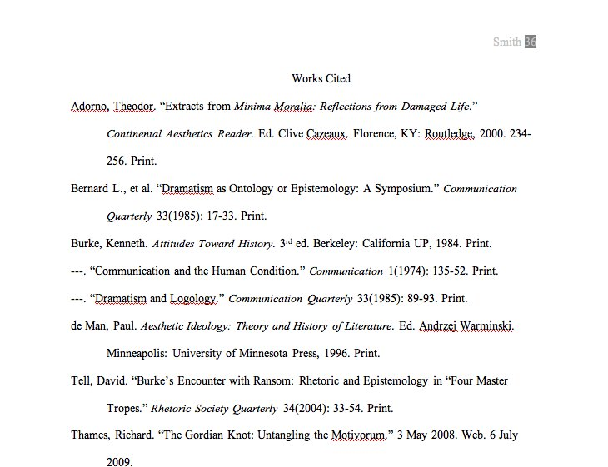

Slide 112
Information taken from the Purdue University Online Writing Lab
http://owl.english.purdue.edu

